Slide 1
Machine Learning Project- Parkinson’s Disease Predictor
Review- 3
Group-127

Slide 2


Group -127
20BCE10693 :- Pritosh Thomas
20BCE10107 :- Rikin Correya
20BCE10494 :- Nayan Agarwal
20BCE10441 :- Chirayu Jaiswal
20BCE10663 :- Devansh Kumar
Guide
Dr. ABHA TRIVEDI

Slide 3

Table of contents
1
Introduction
2
Objective
Flow Diagram
Architectural Diagram
3
4
Modules Explanation
6
Module Implementation
5
7
Glimpses Of The Website
References
8

Slide 4

INTRODUCTION

Slide 5

Parkinson‘s Disease
A progressive disease of the nervous system marked by tremor, muscular rigidity, and slow, imprecise movement, chiefly affecting middle-aged and elderly people. It is associated with degeneration of the basal ganglia of the brain and a deficiency of the neurotransmitter dopamine.
About the Python Machine Learning Project
In this Python Machine Learning Project, using the Python Libraries Scikit-learn, NumPy, and Pandas, we will build a model using an XGB Classifier. We’ll load the data, get the features and labels, scale the features, then split the dataset, train and build the XGB Classifier model, and then finally also test it and calculate the accuracy of our model in detecting Parkinson’s Disease.
Dataset for the Python Machine Learning Project
We will use the Parkinson’s dataset from the University of California, Irvine Machine Learning Repository, in order to train, test and create the model.
8

Slide 6

Objective
The main objective is to develop an accurate machine learning model that can predict whether a patient has Parkinson’s Disease or not, based on the values of the corresponding attributes in the data.

Slide 7

FLOW
DIAGRAM

Slide 8

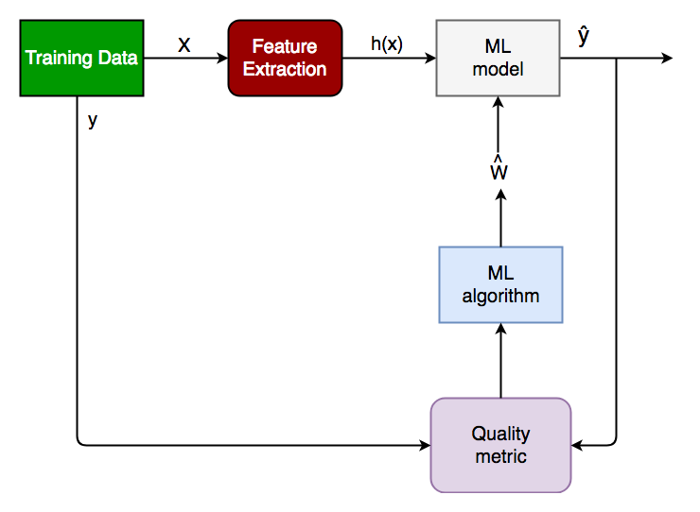
3

Slide 9
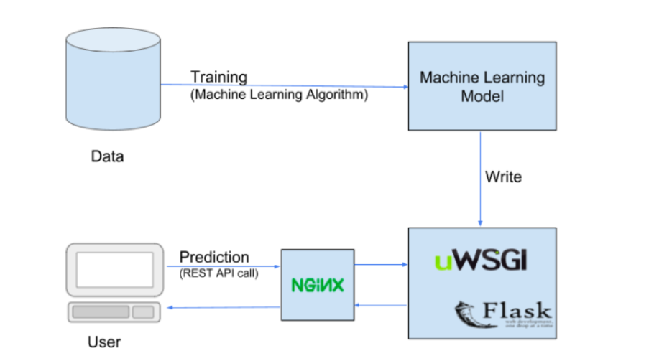
ARCHITECTURAL DIAGRAM

Slide 10


MODULE EXPLANATION
We have created the machine learning model and after training and testing the model using XG Boost we received an accuracy of above 90%. We have also created the initial frontend of our website which contains more information and data about the disease, its symptoms and potential treatment.

Slide 11

FRONT END
We have built the front end of our website using HTML, CSS and JavaScript that will be linked to the machine learning model so that users can enter the values of the respective columns in the dataset. We are using HTML, CSS, JavaScript for our frontend part as they are the base of every website.
HTML
CSS
For, the content part we are using HTML for the basic.
And to make the website look more unique and attractive,we will use CSS which will give styling effects to the website.
https://github.com/Pritosh4/Parkinsons-Detector

Slide 12

Backend
To link the model with our website so that it is responsive when a user enters the data, we will be using Flask. Flask will integrate the front end with our tried and tested machine learning model so that users can easily enter their data and get the results.

Slide 13
Glimpses Of The Website
7

Slide 14
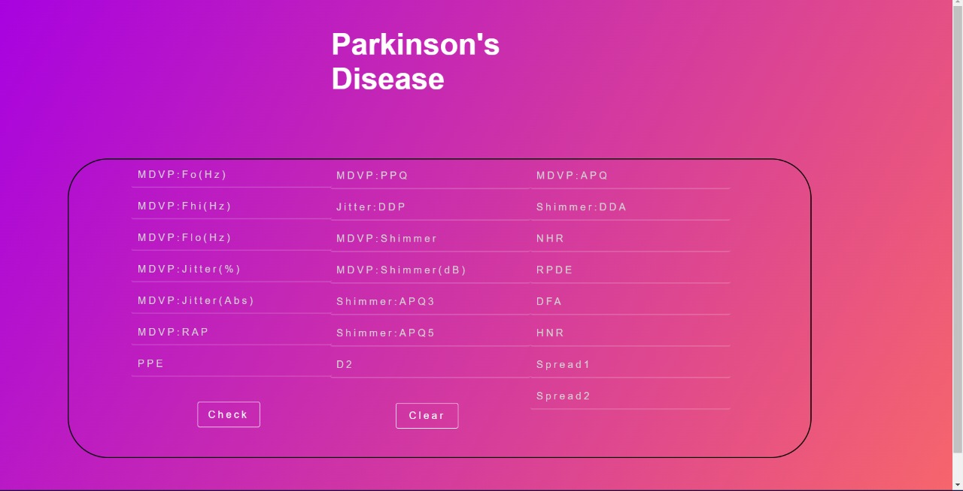

Slide 15
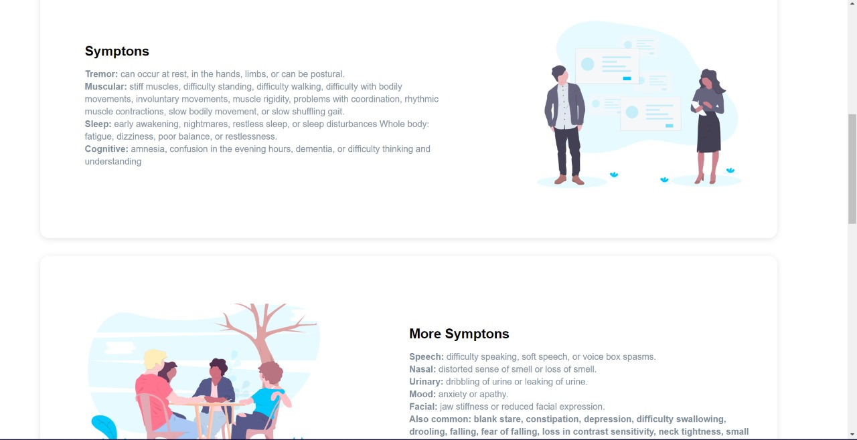

Slide 16
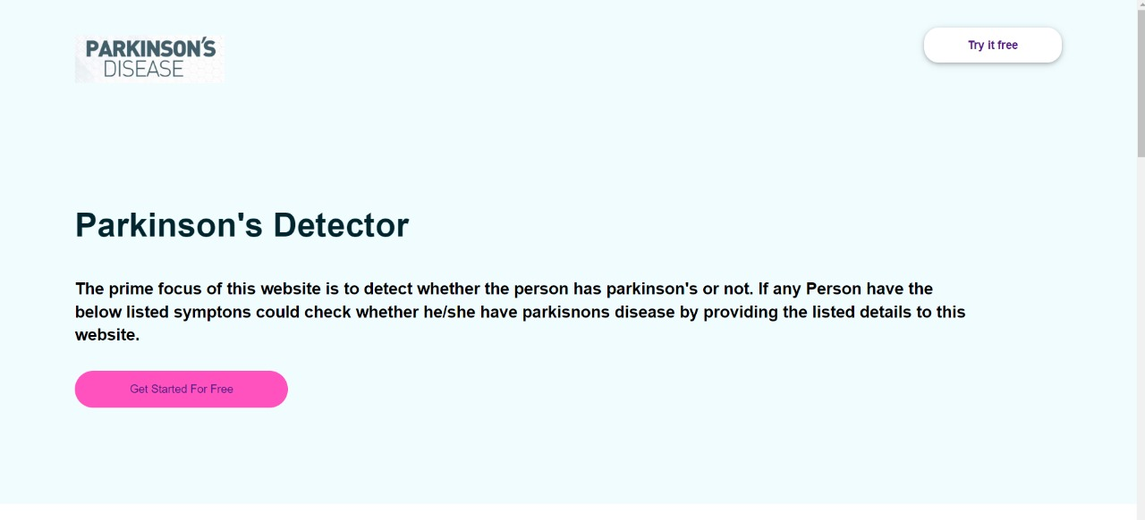

Slide 17
8
References

Slide 18
https://machinelearningmastery.com/gentle-introduction-xgboost-applied-machine-learning/
https://www.nvidia.com/en-us/glossary/data-science/xgboost/
https://www.geeksforgeeks.org/getting-started-with-classification/
https://www.lexico.com/definition/parkinson's_disease

Slide 19

THANK YOU

